Slide 1
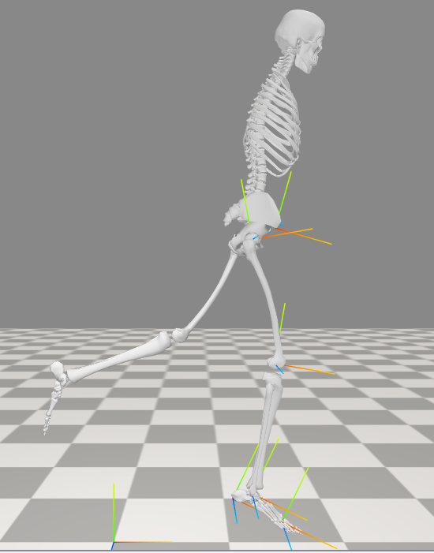
Trajectory Optimization of a human skeleton
Simulation of movement
Yago Trias Vila

Slide 2
Introduction
10 DOF skeletal model
3 absolute coordinates
7 relative coordinates of the human joints and 7 joint moments
4 contact forces:
F1, F2 at the toes and calcaneus from the right leg
F3, F4 at the calcaneus and the toes from the left leg

Slide 3
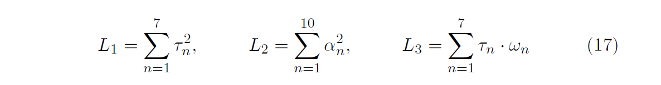
Work developed
Computation of the contact forces and cost functions
Sum of joint moments squared
Sum of angular accelerations squared
Sum of power

Slide 4
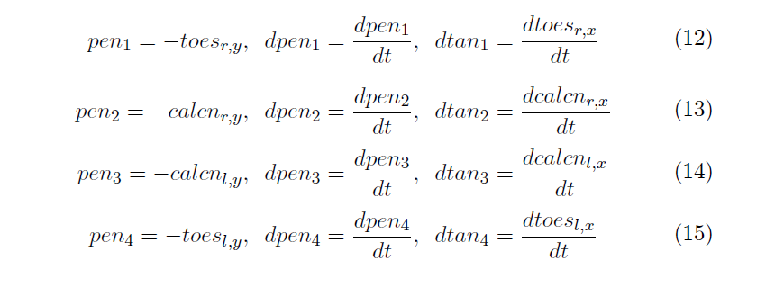
Work developed
Computation of the contact forces and cost functions
Pen
dPen
dTan

Slide 5
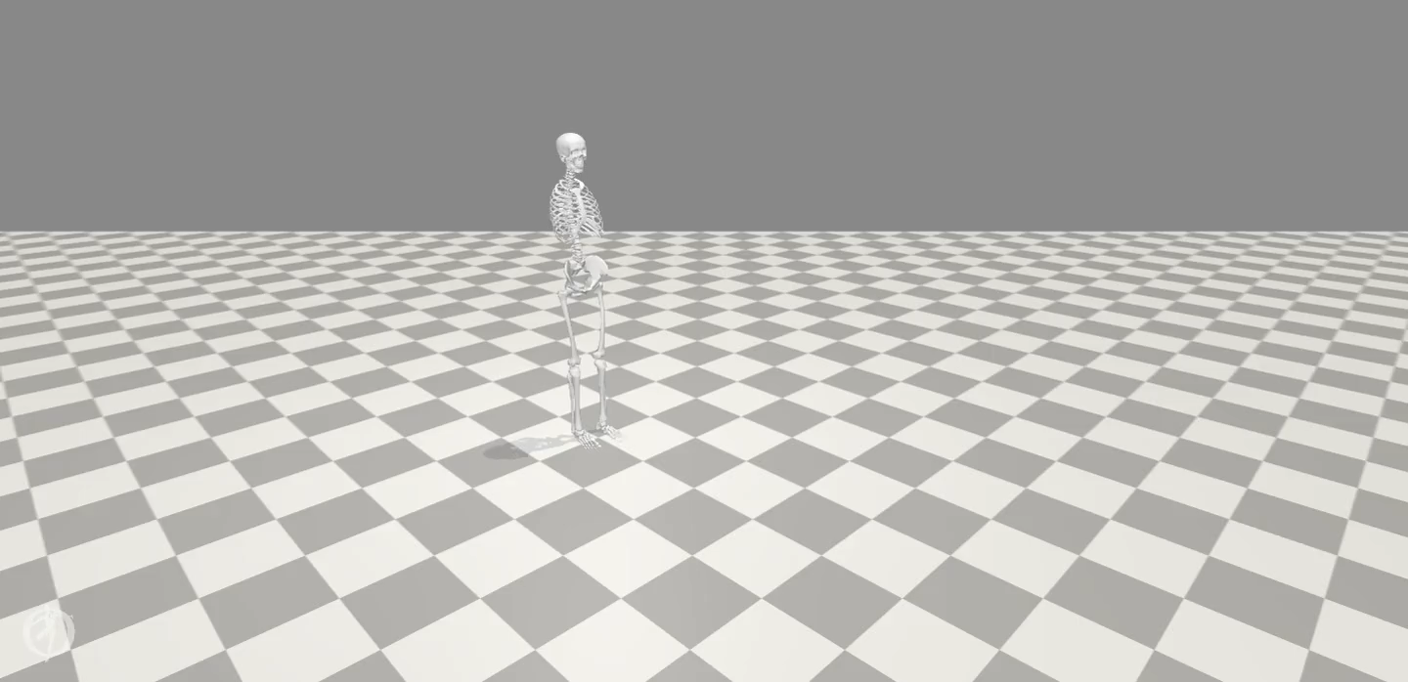
Results
L1

Slide 6
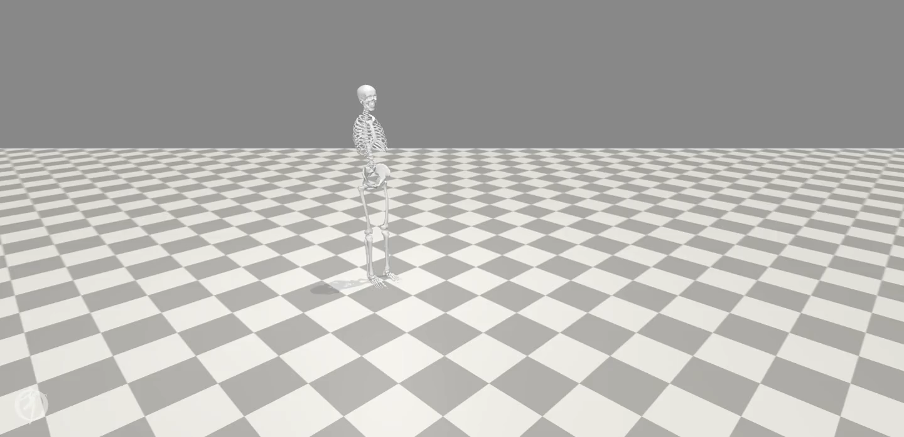
Results
L1 + L2

Slide 7

Results
L1 + L2+L3

Slide 8
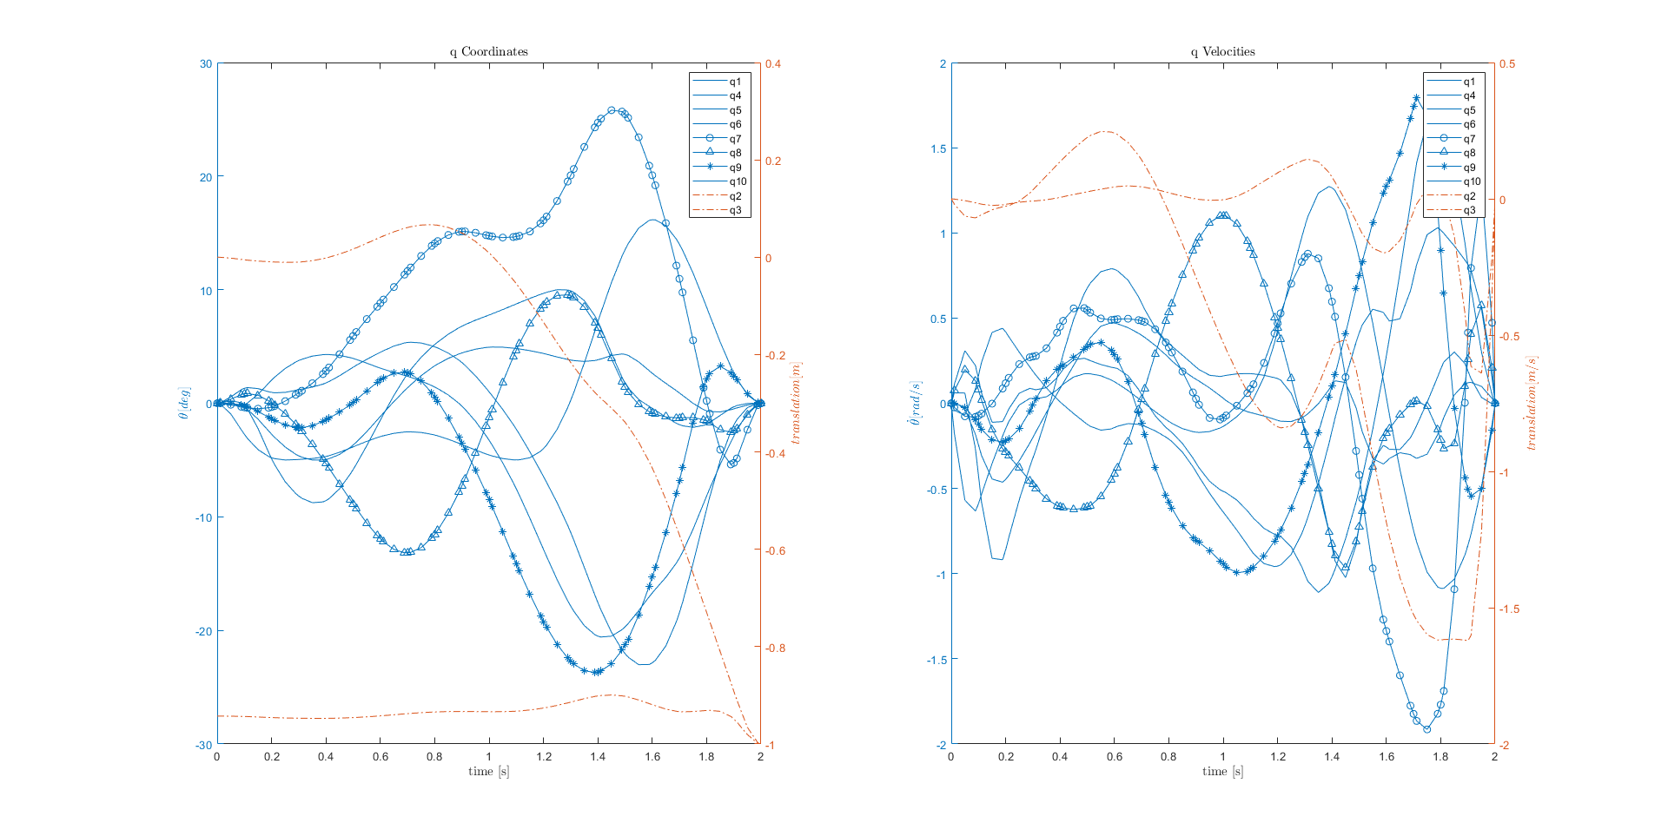
Results
L1 + L2+L3

Slide 9
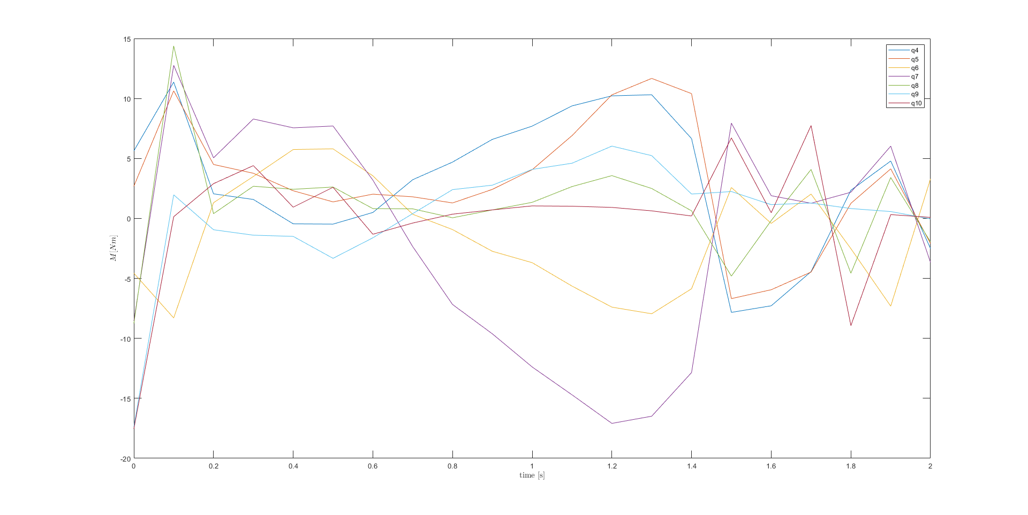
Results
L1 + L2+L3

Slide 10
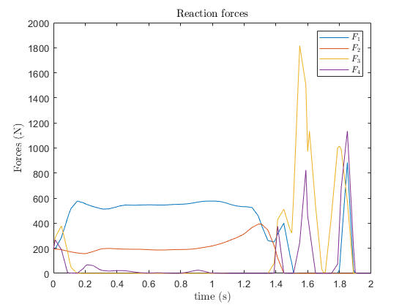
Results
L1 + L2+L3

Slide 11
Conclusions
Simulation of movement
Understand the model selected, MATLAB & CasADI
Effective digital twins

